Slide 1
Introduction to Machine Learning
Anupam Guha

Slide 2
Modern History
1951 Ferranti Mark 1
1954 AI Boom
1956 Dartmouth Workshop
ELIZA
1974 First AI Winter
1980 Expert Systems Boom
1987 Bust
1993 – 2011 Victory of the Neats
Since 2011Deep Learning and Big Data

Slide 3
What is Machine Learning?
Algorithms that improve automatically through experience by using data
Data is unprocessed information
Information is data after processing
Training Data
Testing Data
Validation Data

Slide 4
Features
What are features?
Choosing good features
Curse of Dimensionality and Dimensionality reduction
Metrics: Correlation, mutual information, class separability
Can we use raw data as features?

Slide 5
Jargon
Cross Validation
Active Learning
Ensemble Learning
Oracle
Overfitting
Explainability
Bias

Slide 6
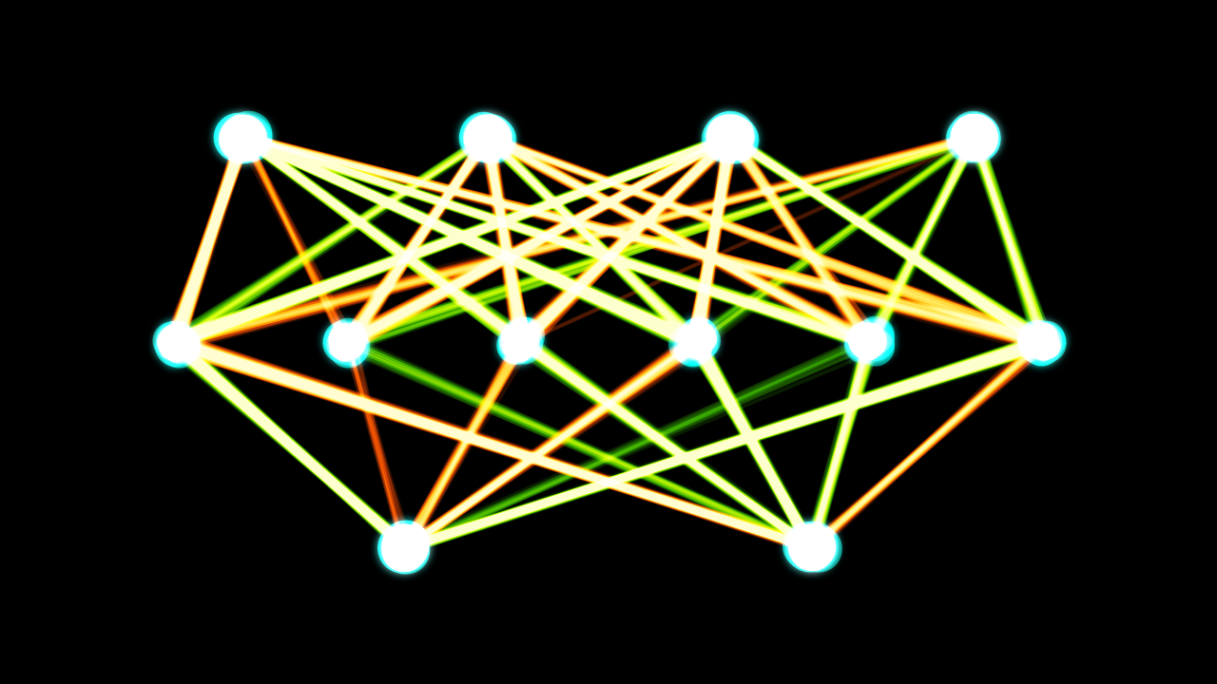
Deep Learning

Slide 8


Slide 9
Supervised ML
Classification
Regression
Where do we get annotations from?
Determining the best algorithm
Bias-variance trade-off
Complexity of algorithm

Slide 10
Classification
Decision Trees
Bayesian Classifiers
Neural Networks
K-Nearest Neighbour
Support Vector Machines
Deep neural networks

Slide 11
Regression
Linear regression
Logistic regression

Slide 12
Unsupervised ML
Clustering
Anomaly Detection
Expectation Maximization
Topic Models
Parameters
Chinese restaurants and Indian buffets

Slide 13
Neural Networks in Unsupervised
Autoencoders
Generative Adversarial Networks
Deep belief network

Slide 14
Discussion www.anupamguha.com

Slide 15
An introduction to Python
Anupam Guha

Slide 16
What is coding?
What is a language? What is an algorithm?
Various kinds of languages
Compilers and interpreters
Why use Python? Which Python?
Everyone installs Python
IDLE
Using the command line in your OS

Slide 17
Basic Python commands
Comments
Keywords, identifiers
print() and input()
+ - * /
** %
Data types and type conversion
Strings
Overloading of operators
String as a list, len(), indexing etc
split() and join()

Slide 18
Comparisons
Comparison operators > < >= <= == !=
Assignment vs comparison
+= -= etc
if, else, elif
Boolean variables TRUE FALSE
Boolean operators and or not
Identity (is) and membership (in)

Slide 19
Data, loops and functions
More on lists, set, tuple, dict
for, with list, range etc, loop in a list itself
while, types of while
break and continue
A basic function
iteration and recursion

Slide 20
Discussion

